Slide 1

Capstone
Project

Slide 2



Personal BACKGROUND
(Name, Past Experience, Qualification, Career Summary)
Name : Gelle Hruthesh Reddy
Past Experience : Worked on full-stack web applications using the MERN stack and built AI/ML projects using Python and PyTorch.
Qualification : Bachelor of Technology in Computer Science
Career Summary :
A Bachelor of Technology in Computer Science graduate with a solid foundation in software development and a passion for full-stack development and AI/ML. Experienced in building web applications using the MERN stack and developing intelligent solutions with Python. Eager to contribute to a dynamic tech environment.
www.collaberadigital.com

Slide 3


Key Takeaways/Learnings from the Program (HTD)
Java Proficiency: Strong understanding of OOP principles, exception handling, and multithreading
Database & JDBC: Practical knowledge of SQL queries and integrating Java applications with MySQL using JDBC.
Spring & Microservices: Built scalable RESTful applications using Spring Boot, and Spring Data JPA. Exposure to microservices architecture, service discovery, and API gateways.
API Development & Testing: Proficient in working with REST APIs, HTTP methods, and testing APIs using Postman, including automation and chaining requests.

Slide 4

Problem Statement of the Capstone Project
Develop a simplified job board platform using React, Spring Boot, and MySQL that enables users to browse, search, and apply for jobs with ease. The application emphasizes user-friendly navigation, role-based search, and application submission, while showcasing full-stack development skills and best practices.

Slide 5
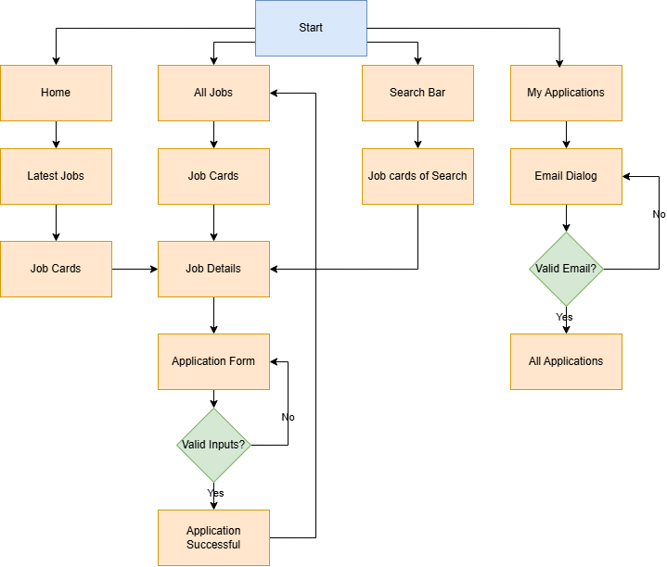
Flowchart of the Project

Slide 6
Additional features to the Project
A My Applications page where users can view all the jobs they have applied for, including job title, company name, and application status, helping them track their submissions easily.
A Responsive Design that ensures the entire application – including landing page, job search, job details, and application form – works seamlessly across desktop, tablet, and mobile devices for a consistent user experience.

Slide 7
List of tools used for Capstone
React for Front-end development framework for creating responsive and interactive user interfaces.
Material UI for styling with modern, consistent design elements.
Spring Boot for building robust and scalable backend APIs using Java, including RESTful services.
Spring Data JPA for simplifying database interaction and ORM mapping between Java classes and MySQL tables.
MySQL for storing job listings and user application data in a relational database.
Postman for testing RESTful API endpoints during backend development and debugging.

Slide 8
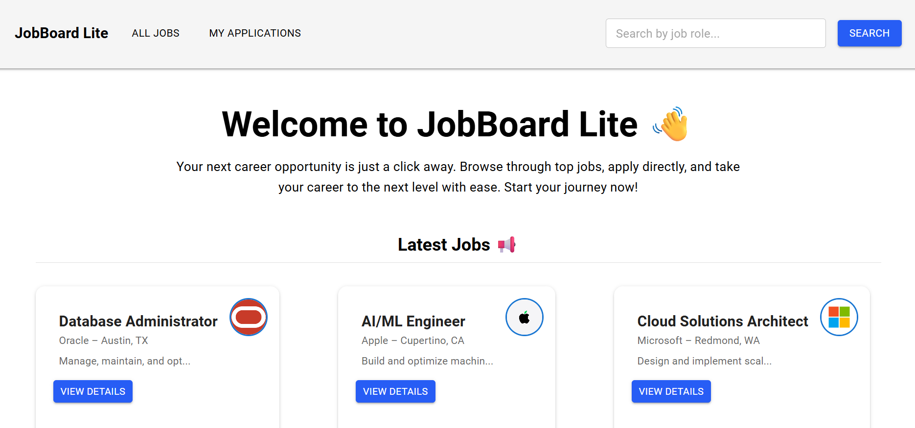
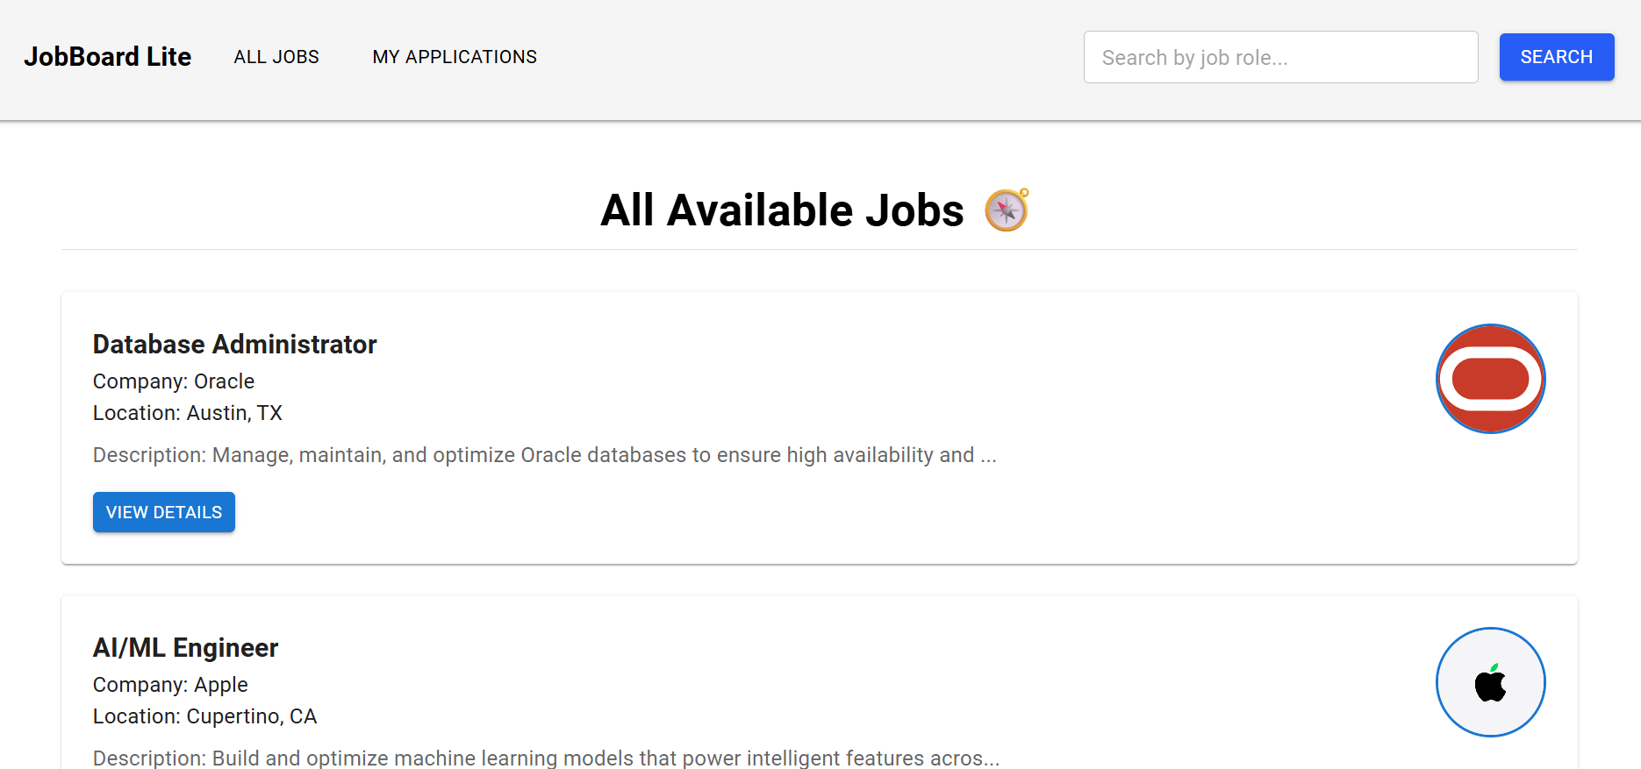
Important areas of the Project with screenshots
Home Page: Users can view a welcome message, featured jobs, and search for roles.
All Jobs Page: Users can browse and search all available job listings.
Home Page
All Jobs Page

Slide 9
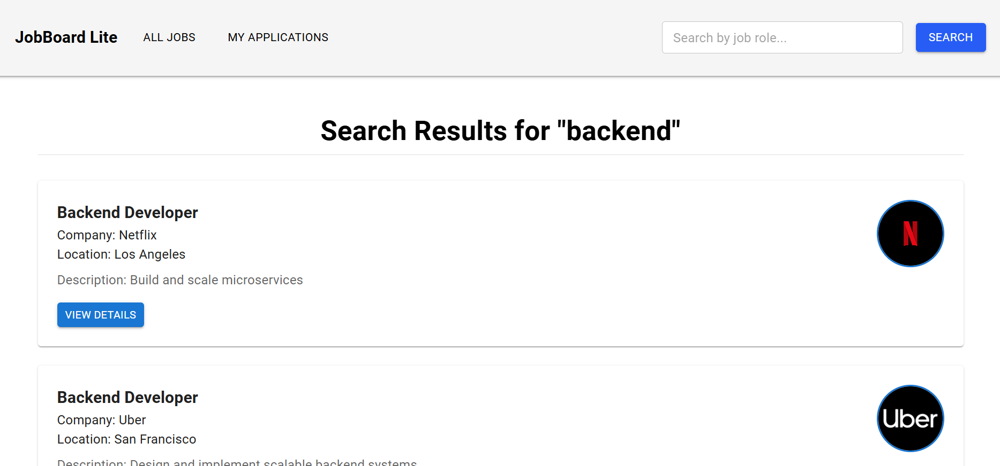
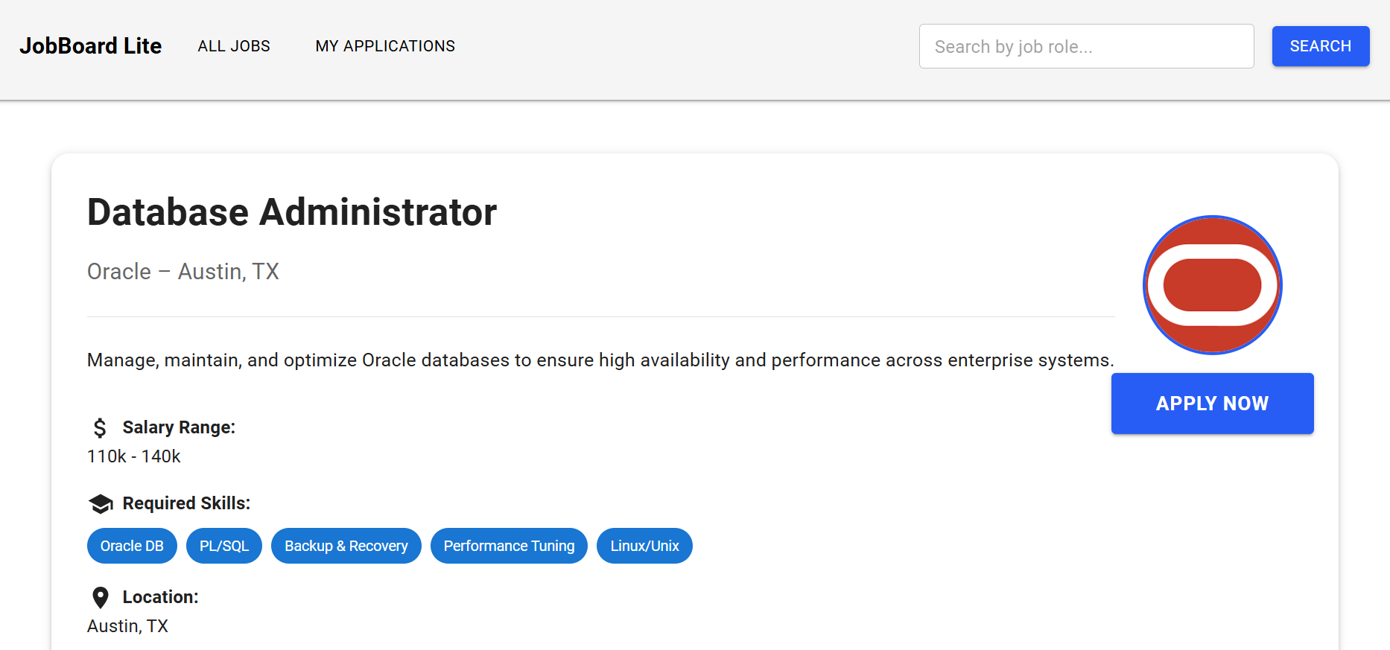
Important areas of the Project with screenshots
Search Results Page: Users can view jobs filtered by the searched role.
Job Details Page: Users can view full details of a selected job and apply.
Search Results Page
Job Details Page

Slide 10
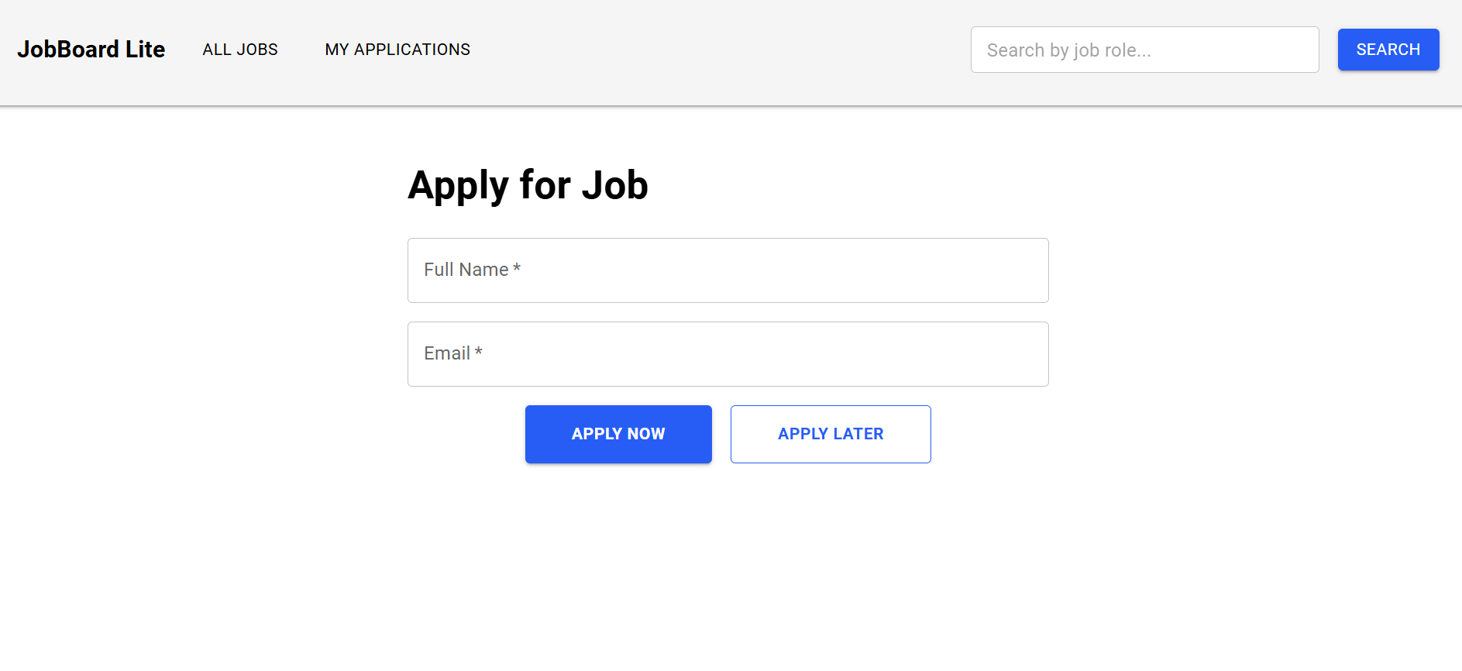
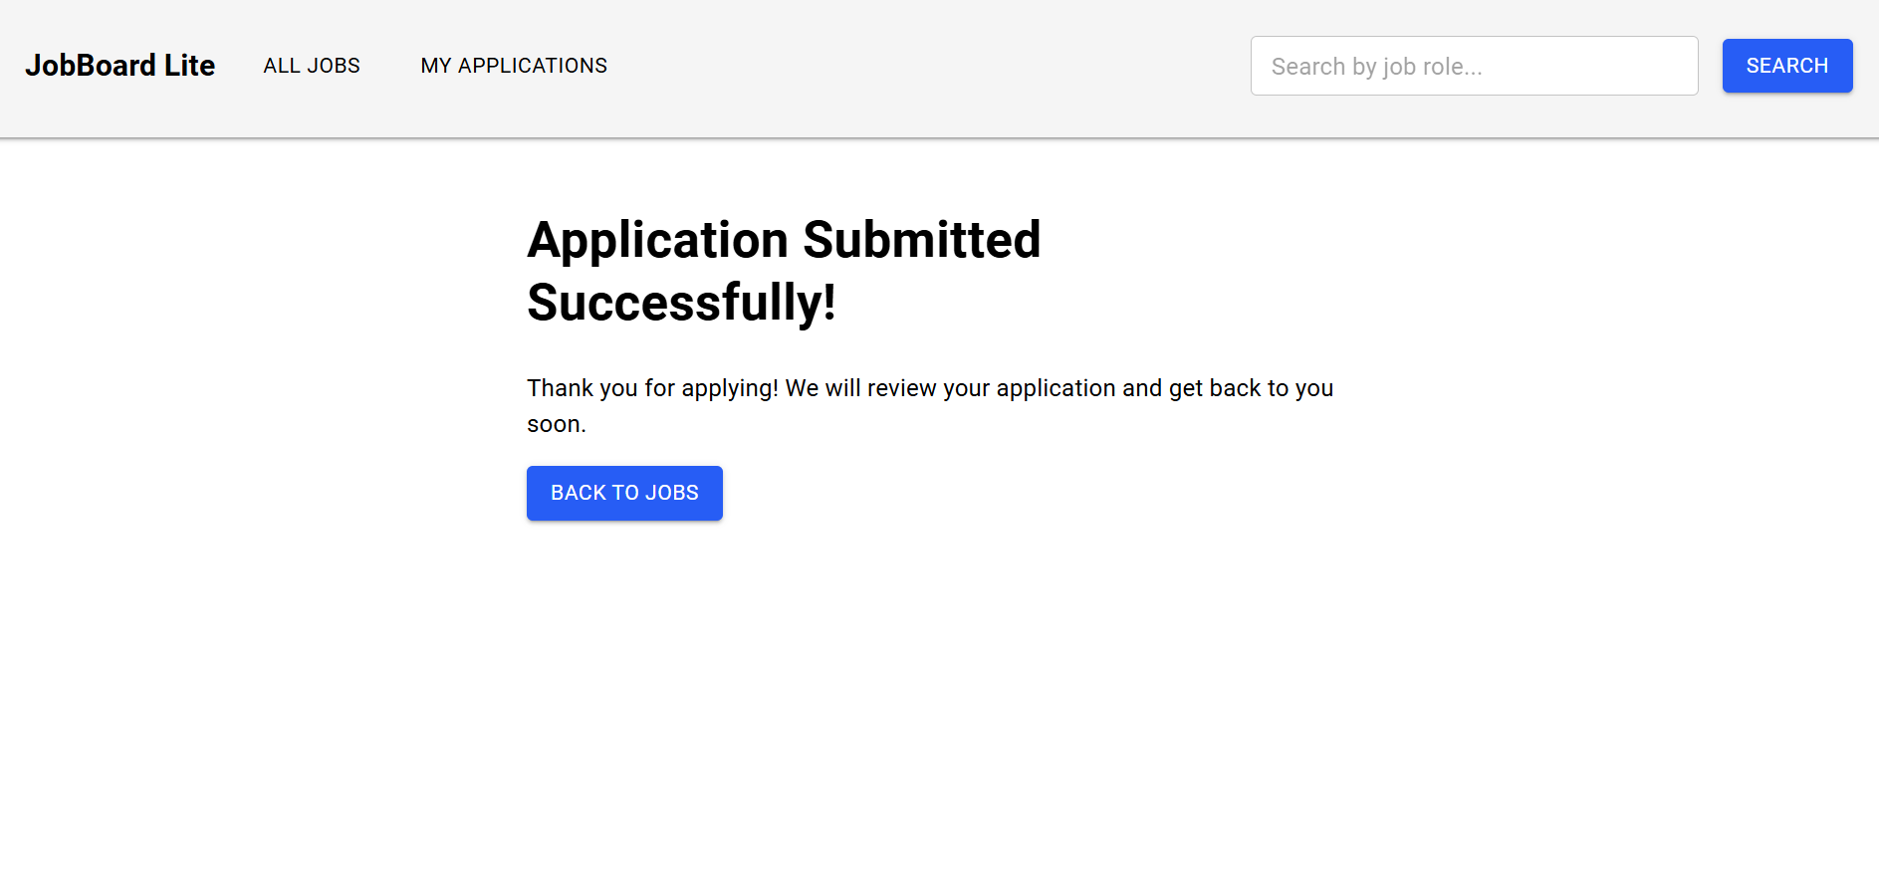
Important areas of the Project with screenshots
Application Page: Users can fill out and submit a job application form.
Application Success Page: Users see a confirmation message after applying.
Application Page
Application Success Page

Slide 11
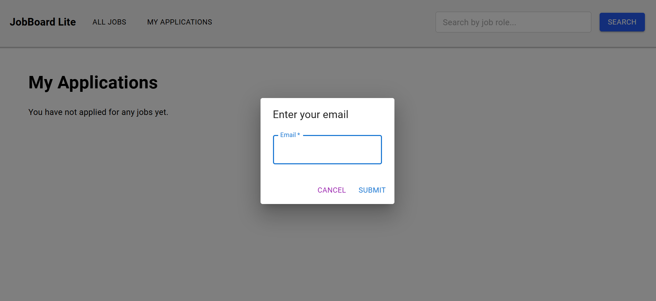
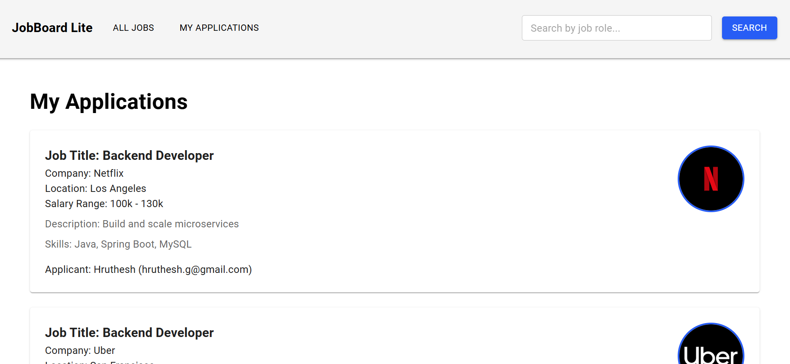
Important areas of the Project with screenshots
Email Dialog: A popup dialog to enter and validate the user's email before applying.
My Applications Page: Users can view the list of jobs they have applied for.
Email Dialog
My Applications Page

Slide 12
Conclusion
Job Board Lite is a simplified full-stack job board application built with Spring Boot and React. It allows users to browse, search, and apply for jobs with ease. The project demonstrates key full-stack development skills, including RESTful APIs, dynamic frontend components, and form handling. It meets core objectives while providing a solid foundation for future enhancements like authentication and advanced search.

Slide 13
Thank You

